Slide 1
Crop Science
Lecture 4
August 2022
PLANT GROWTH AND DEVELOPMENT

Slide 2
Plant growth and development
Meristems are populations of small cells with embryonic characteristics
Vegetative meristems are self-perpetuating that do not only produce the tissues that will form the body of the root or stem, but they also continuously regenerate themselves
A meristem can retain its embryonic character indefinitely
Meristematic cells do not differentiate and retain the capacity for cell division, as long as the meristem remains vegetative

Slide 3
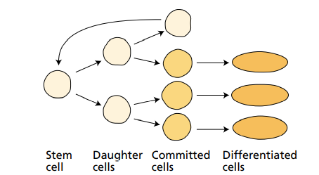
Cell division
Undifferentiated cells that retain the capacity for cell division indefinitely are called stem cells
When stem cells divide, one daughter cell retains the identity of the stem cell, while others commit to a particular developmental pathway

Slide 4
Cell division
Plants also develop secondary meristems during development
Secondary meristems can have a structure similar to that of primary meristems, but some secondary meristems have a quite different structure
These include:
• Axillary meristems growth and development produces branches from the main axis of the plant
• Intercalary meristems of grass leaves and stems enables them to continue to grow despite mowing or grazing by cows
• Branch root meristems, promote root growth

Slide 5
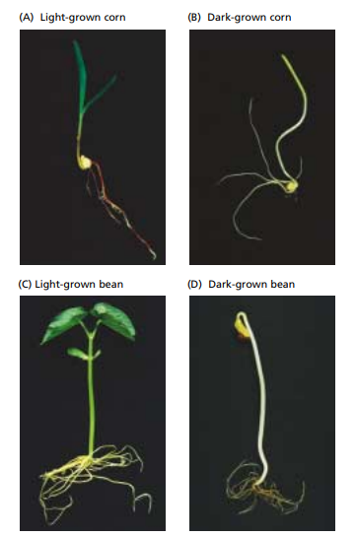
Light contribution to plant growth

Slide 6
Control of plant development
Given the key role of photosynthesis in plant metabolism, might be tempting to attribute much of this contrast to differences in the availability of light-derived metabolic energy
It takes very little light or time to initiate the transformation from the etiolated to the green state
In the change from dark to light growth, light acts as a developmental trigger rather than a direct energy source

Slide 7
Plant development
Light acts as a signal to induce change in the form of the seedling,
seedling uses primarily stored seed reserves for etiolated growth
Seed plants don’t store enough energy to sustain growth indefinitely
Seedlings require light energy not only to fuel photosynthesis, but to initiate the developmental switch from dark to light growth

Slide 8
Photochemical and biochemical properties of phytochrome
Phytochrome is a blue protein pigment
Phytochrome is most abundant in etiolated seedlings
Very little phytochrome is extractable from green tissues, and a portion of the phytochrome that can be extracted differs from the abundant form of phytochrome found in etiolated plants
In etiolated seedlings the highest phytochrome levels are usually found in meristematic regions or in regions that were recently meristematic, such as the bud and first node

Slide 9
Change in light condition
Wavelengths of light provide information that helps plants adjust to their environment
An important function of phytochrome is that it enables plants to sense shading by other plants
Plants increase stem extension in response to shading

Slide 10
Photo physiology of blue-light responses
Blue-light signals are utilized by the plant in many responses, allowing the plant to sense the presence of light and its direction
Directional growth toward (or in special circumstances away from) the light, is called phototropism
Phototropism is a photo morphogenetic response that is particularly dramatic in dark-grown seedlings of both monocots and dicots

Slide 11
Blue light signals
Plants utilize light as a source of energy and as a signal that provides information about their environment
A large family of blue-light responses is used to sense light quantity and direction
These blue-light signals are transduced into electrical, metabolic, and genetic processes that allow plants to alter growth, development, and function in order to acclimate to changing environmental conditions
Blue light responses include phototropism, inhibition of stem elongation, tracking of the sun by leaves

Slide 12
Growth hormones
Auxin was the first growth hormone to be discovered in plants, and much of the early physiological work on the mechanism of plant cell expansion was carried out in relation to auxin action
Differential growth occurs due to the increase in auxin on one side stimulated cell elongation, and the decrease in auxin on the other side caused a decrease in the growth rate
In most higher plants, the growing apical bud inhibits the growth of lateral buds—a phenomenon called apical dominance

Slide 13
Function of Auxins
Auxin Delays the Onset of Leaf Abscission, the shedding of leaves, flowers, and fruits from the living plant is known as abscission
Auxin levels are high in young leaves, progressively decrease in maturing leaves, and are relatively low in senescing leaves when the abscission process begins
Auxin transported from the blade normally prevents abscission
Abscission is triggered during leaf senescence, when auxin is no longer being produced

Slide 14
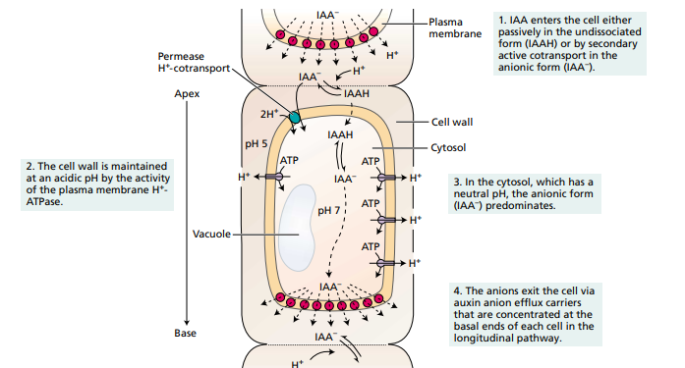

Slide 15
Application of auxin
Auxin is involved in the regulation of fruit development and is produced in pollen, in endosperm, developing seeds
Auxins have been used commercially in agriculture many years
The early commercial uses included:
prevention of fruit and leaf drop
promotion of flowering in pineapple
thinning of fruit
Rooting of cuttings for plant propagation, rooting is enhanced if the excised leaf or stem cutting is dipped in an auxin solution
Seedless fruits may be may be induced by treatment of the unpollinated flowers with auxin

Slide 16
Auxin application
Today auxins are widely used as herbicides
Maize and other monocotyledons can rapidly inactivate synthetic auxins

Slide 17
Gibberellin
Originally discovered as the cause of a disease of rice that stimulated internode elongation
In addition to stem elongation gibberellins:
control various aspects of seed germination, including the loss of dormancy and the mobilization of endosperm reserves
In reproductive development, gibberellin can affect the transition from the juvenile to the mature stage,
Floral initiation
Fruit set

Slide 18
Gibberellins activity
Gibberellins Regulate the Transition from Juvenile to Adult Phases
Gibberellin is thus a component of the flowering stimulus in some plants
Gibberellins Are Biosynthesized in Apical Tissues and are found in immature seeds and developing fruits
Gibberellin level normally decreases to zero in mature seeds, there is no evidence that seedlings obtain any active gibberellins from their seeds
Gibberellins also have been identified in root exudates and root extracts, suggesting that roots can also synthesize gibberellins and transport them to the shoot through the xylem

Slide 19
Physiological mechanisms of gibberellin-induced growth
When dwarf plants are treated with gibberellin, they resemble the tallest varieties of the same species
Gibberellin action include the elongation of shoots and of grass internodes
Gibberellin increases both cell elongation and cell division, this can be seen by increases in cell length and cell number in response to applications of gibberellin

Slide 20
Biosynthesis of ethylene
Ethylene can be produced by almost all parts of higher plants only the rate of production depends on the type of tissue and the stage of development
Meristematic regions and nodal regions are the most active in ethylene biosynthesis
Ethylene production increases during leaf abscission and flower senescence, as well as during fruit ripening

Slide 21
Environmental Stresses for Ethylene Biosynthesis
Ethylene biosynthesis is stimulated by several factors including:
Fruit ripening As fruits mature, the rate of ethylene biosynthesis increases
Stress-induced ethylene production biosynthesis is increased by stress conditions such as drought, flooding, chilling, exposure to ozone, or mechanical wounding
Other plant hormones

Slide 22
Developmental and physiological effects of ethylene
Ethylene Promotes the Ripening of Some Fruits In everyday usage, the term fruit ripening refers to the changes in fruit that make it ready to eat
Ethylene Induces Lateral Cell Expansion
Ethylene Breaks Seed and Bud Dormancy in Some Species
Ethylene Promotes the Elongation Growth of Submerged plants
Ethylene Induces Flowering in the Pineapple Family
Ethylene Enhances the Rate of Leaf Senescence

Slide 23
Application of Ethylene
ethylene regulates so many physiological processes in plant development, it is one of the most widely used plant hormones in agriculture
Used in the fruit industry to increase the ripening process

Slide 24
Abscisic Acid
Abscisic acid plays major roles in seed and bud dormancy, as well as responses to water stress
ABA is synthesized in almost all cells that contain plastids and is transported via both the xylem and the phloem
The level of ABA fluctuates dramatically in response to developmental and environmental changes
ABA is required for the synthesis of storage proteins, and the acquisition of dormancy
During water stress, the ABA level of the leaf increases
ABA increases the hydraulic conductivity of the root

